Slide 1
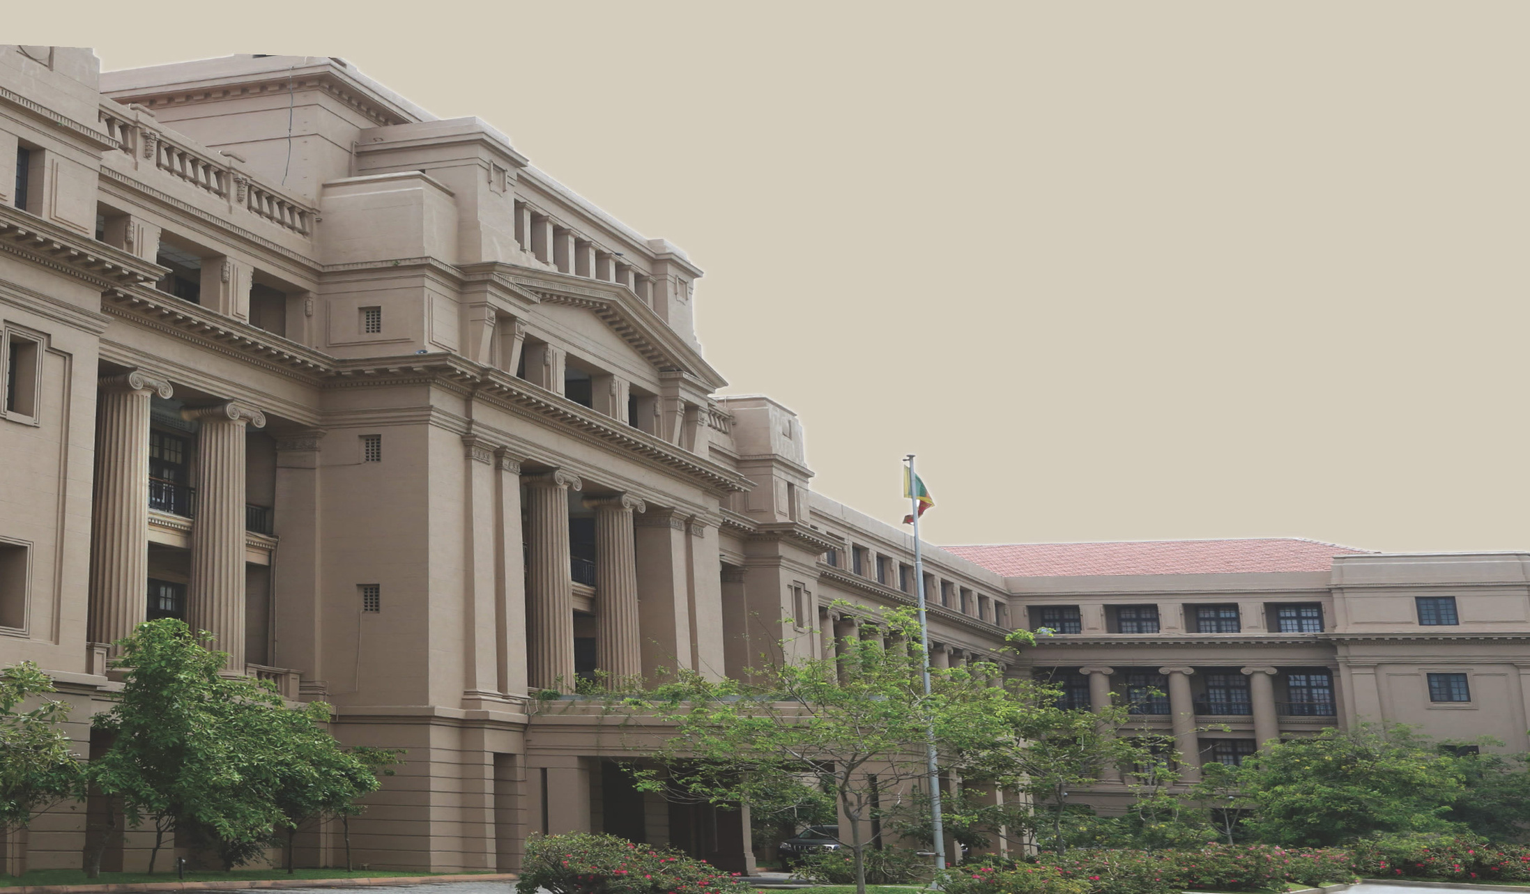





NATIONAL AGENCY FOR
PUBLIC PRIVATE PARTNERSHIP
Ministry of Finance, Planning and Economic Development
Kurinchathivu Saltern ProjectRehabilitation, Development and RecommencementPublic–Private Partnership (PPP) – DBFOMT Model

Slide 2

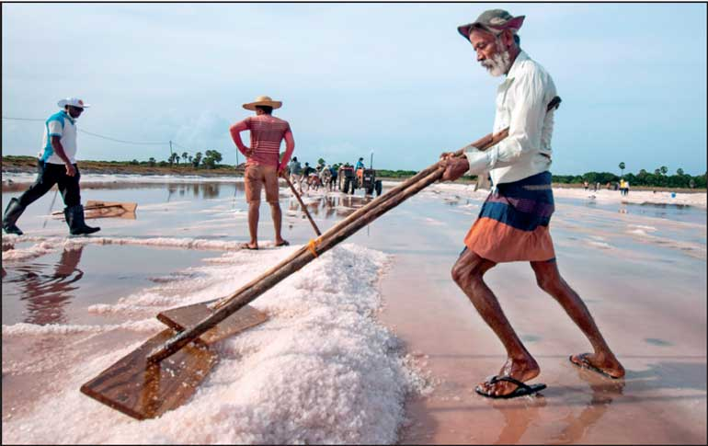


Background of National Salt Limited
  Originated from the Salt Department established in 1938
  Operated under different administrative structures over time
  Renamed as National Salt Limited (NSL) in June 2021
  Functions under the Ministry of Industry and Entrepreneurship Development
  Registered under Companies Act No. 7 of 2007
  Certified by Sri Lanka Standards Institution
  Audited by the Auditor General’s Department
  Key production locations:
    Mannar Saltern
    Elephant Pass Saltern
  Focus on:
    Quality salt production (≈96% NaCl)
    Employment for vulnerable communities in Northern Province

Slide 3




Current Salt Industry Context in Sri Lanka
    Annual national demand: Approx 200,000 MT
      Household consumption
      Industrial demand
    Existing salterns meet demand only under favourable weather
    Climate variability causes periodic supply shortages
    Future demand expected to increase by ~20,000 MT
    Linked to Paranthan Chemical Factory recommencement
    Export potential exists if domestic self-sufficiency is achieved

Slide 4
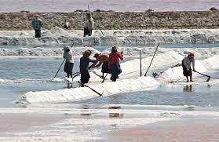
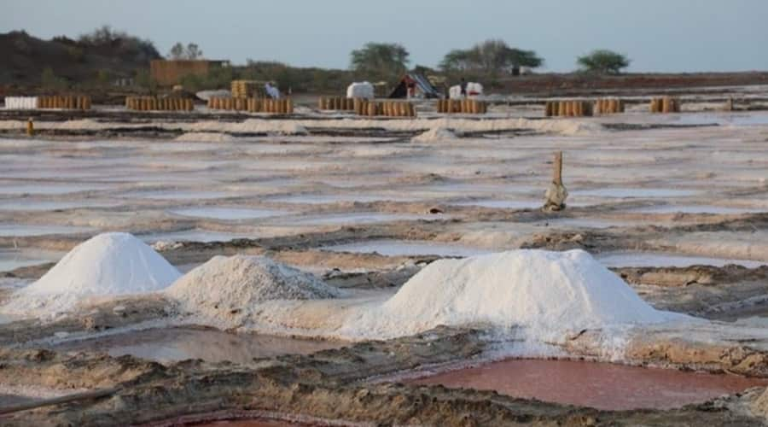
Kurinchathivu Saltern: Project Background
    Located in Pachchilaipalli DS Division, Kilinochchi District
    Adjoining A9 Road, Northern Province
    Non-operational for over 34 years due to conflict
    Basic infrastructure remains:
      Salt pans
      Deep tanks
    Land status:
      750 acres saltern land
      423 acres lagoon used as primary reservoir
    Land cleared of mines
    Potential production capacity:
      Minimum 30,000 MT per annum under favourable conditions

Slide 5
Government Policy and Approval
    Project approved by Cabinet of Ministers
    Cabinet Decision dated 18.08.2025
    Implemented under Government PPP FrameworkTwo-stage procurement process:
      Expression of Interest (EOI)
      Request for Proposal (RFP)
    Cabinet Appointed Negotiation Committee (CANC) established
    Project structured in line with PPP Guidelines and Regulations

Slide 6
Proposed PPP Model
    Concession period:
      20 years (excluding 2-year construction period)
    Private sector:
      Fully finances the project
      Designs, builds, operates, and maintains facilities
    Government:
      Provides land and existing infrastructure
      Regulatory oversight
    Assets transferred to NSL at end of concession

Slide 7
Methodology / Implementation Approach
    Step 1: Private Investment
      100% private financing (CAPEX + working capital)
    Step 2: Rehabilitation & Development
      Restore existing saltern infrastructure
      Introduce modern production technology
      Complete within 2 years
    Step 3: Operations
      Raw salt production
      Value-added processing
      Domestic and export marketing
    Step 4: Transfer
      Handover of assets to NSL after concession period

Slide 8


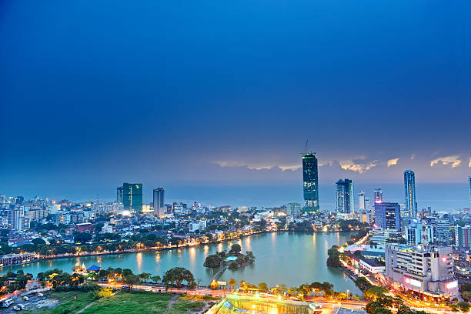






THANK YOU
NAPPP
+94 11 348 7605
nappp@mo.treasury.gov.lk
www.reallygreatsite.com
3ʳᵈ Floor, Lotus Building, Temple Trees, Colombo 03.

